Slide 1


Introduction ADMB Workshop Alaska Department of Fish and Game March 2018
Merrill Rudd
merrillrudd@gmail.com
With special thanks to Arni Magnusson, Rob Ahrens and Andre Punt

Slide 2
Objectives
Goals during this workshop
Gain fundamentals to implement and review age-structured assessments
HAM, yelloweye rockfish, sablefish, etc.
Analysis of model results in R
Connecting population dynamics concepts to code
Goals after this workshop
Bring ADF&G assessments to a reproducible framework
Writing ADMB code properly

Slide 3
Overview
Day 1 Statistical overview ADMB approach, syntax, files, output Developing likelihoods Debugging | Day 3 Using ADMB for simulation Retrospective analysis Estimating uncertainty
Day 2 Reading ADMB results into R Non-linear models Age-structured models Model diagnostics and selection | Day 4 Work with Herring Assessment Model or other examples

Slide 4
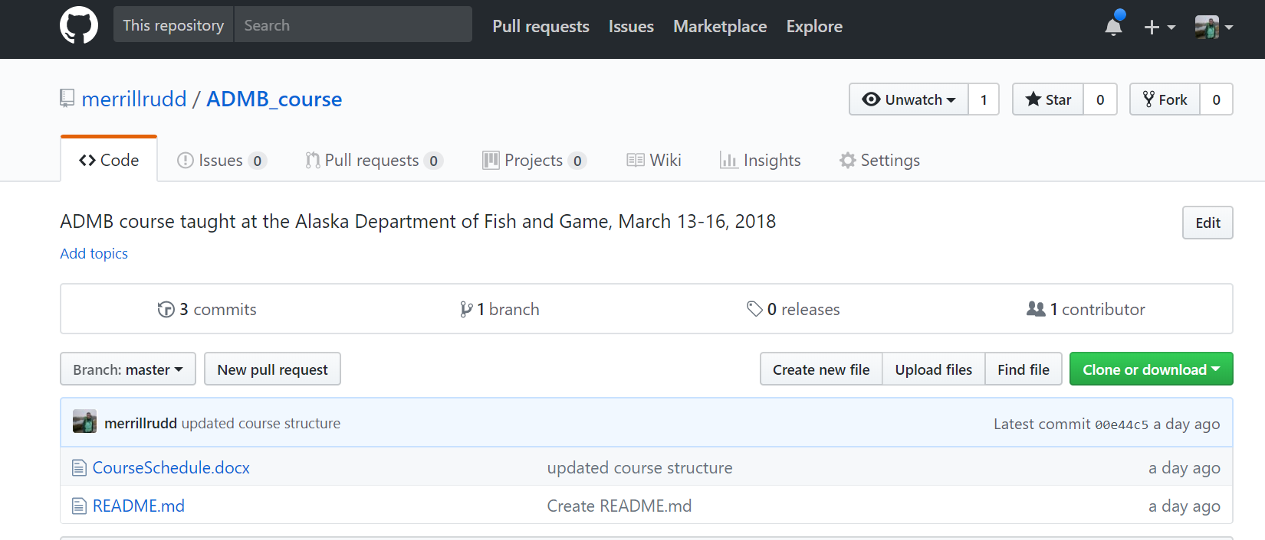
Course website
https://github.com/merrillrudd/ADMB_course
Lectures and example code are available on Github
Clone or download materials where you want to save them

Slide 5
Course website
https://github.com/merrillrudd/ADMB_course
ADMB installation instructions and some background material are available on the “Wiki” page

Slide 6
Course website
https://github.com/merrillrudd/ADMB_course
Write any questions, discussion subjects, or ideas to cover after the workshop under the “Issues” tab

Slide 7
Why use ADMB?
Finds the value of parameter vector that minimizes complex non-linear functions
ADMB is faster, more accurate, and more stable than R optimizers (e.g. “optim”) with more functionality for understanding parameter uncertainty
Estimates asymptotic variance-covariance matrices
Computes likelihood profiles for parameters and model outputs
Sampling parameter vectors from Bayesian posteriors (MCMC)

Slide 8
Maximum likelihood
Given a set of data and probability model, maximum likelihood chooses the values of parameters that make the data “most likely”
Likelihood of the data D given parameter(s) p is the probability of the data given the parameter(s).
Probability = knowing parameters → predicting data
Likelihood = knowing data → estimating parameters

Slide 9
Likelihood basics
If the data consist of two parts D₁ and D₂:
The likelihood of the data D = D₁ + D₂ is the product of the likelihoods of each D₁ and D₂:
D₁ and D₂ can be multiple types of data
Integrated models: e.g. tag resighting, abundance index, etc.
Data point 1
Data point 2

Slide 10


Other likelihood considerations
To compute the likelihood we need:
A model between the input variables and data
The sampling distribution – how the data pertain to the model prediction, e.g. normal distribution:
${\hat{L}}_{a}=L_{∞}(1−\exp\left(−k\left(a−t_{0}\right)\right))$
$L= \frac{1}{\sqrt{2π}σ}e^{−{\left({\hat{L}}_{a}−L_{a}\right)}^{2}/2σ^{2}}$
Model prediction
Data

Slide 11
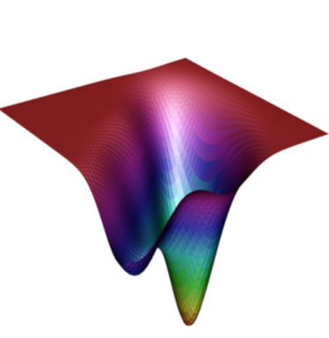
Maximum likelihood
Given a likelihood function, we find the maximum likelihood values for the parameters by:
Maximizing the log-likelihood or
Minimizing the negative log-likelihood
This equation is difficult to solve!

Slide 12
Automatic differentiation
ADMB uses the AUTODIF C++ class library
Combines array language with automatic differentiation
Supplemented with precompiled code for derivatives of common array and matrix operations
User only provides description of statistical model, ADMB handles the process of fitting the model to data and reporting results
Many aspects of C++ programming are hidden from the user

Slide 13
Developing a model and likelihood
User inputs data
User defines the state dynamics model and observation model
ADMB estimates parameters and error terms as fixed or random effects to minimize the objective function
Variability (process error)
Measurement error (observation error)
Parameters
Statistical criterion
State dynamics model
Observation model
(Predicted data)
Observations (Data)

Slide 14






Von Bertalanffy growth model
$$L_{∞}, k, t_{0}$$
$${CV}_{L}$$
Variability (process error)
Measurement error (observation error)
Parameters
$$P(L|a, {CV}_{L})$$
$${\hat{L}}_{a}$$
$$L_{a}$$
Statistical criterion
Von Bertalanffy growth model
Observation model
(Predicted data)
Observations (Data)
$$L_{a}=L_{∞}(1−\exp\left(−k\left(a−t_{0}\right)\right))$$

Slide 15



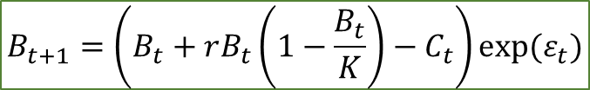




Surplus production model (e.g. Schaefer)
$$ε_{t}\sim N(0,σ_{B})$$
$$σ_{y},σ_{C}$$
$$r, K$$
Variability (process error)
Measurement error (observation error)
Parameters
$${\hat{y}}_{t}=qB_{t}$$
$$B_{t}$$
$${\hat{y}}_{t}$$
$$y_{t}$$
Statistical criterion
Surplus production model
Observation model
(Predicted data)
Observations (Data)
$$B_{t+1}=\left(B_{t}+rB_{t}\left(1−\frac{B_{t}}{K}\right)−C_{t}\right)exp⁡(ε_{t})$$

Slide 16
Ways of estimating uncertainty
Delta method to calculate covariance matrix
Likelihood profiles
Bayesian algorithm to sample posterior distribution (MCMC)

Slide 17
Default estimation of uncertainty: delta method
ADMB uses the delta method to calculate the covariance matrix
Covariance matrix calculated from:
Hessian – matrix of second order partial derivatives
Hessian calculated from:
Jacobian – matrix of first order partial derivatives
Inverse of hessian is a reasonable approximation of the covariance matrix provided the assumption that the optimum solution is approximately linear (simple least squares problem)

Slide 18
Likelihood profiles
Negative log-likelihood, fixing the
parameter to each value in turn
(minimize on the rest of the parameters)
Select a wide range of possible values for p
Fit the model to find the MLE and negative log likelihood
Plot the negative log likelihood against p
ADMB includes option to create likelihood profile
-log
likelihood
MLE
•
•
•
•
•
•
•
Parameter of Interest
Alternative
values for the
parameter

Slide 19
Markov Chain Monte Carlo (MCMC)
ADMB uses Metropolis-Hastings algorithm to sample from the posterior distribution

